Slide 1



AI for good 5g/ml challenge
Classification of Home Network Users to Improve Customer Experience

Slide 2






Team SPEARS-9
Hayden Myers
Kumar
Yash
Anuj Pratap Singh
Chhavi
Nijhawan
Sushma Reddy Mandhadapu

Slide 3


Outline
Data Background
Indicator Importance
Future Scope
Conclusion
Business Recommendations
Data Cleaning and Outlier Detection
Problem Statement
Model Evaluation Summary
Appendix

Slide 4
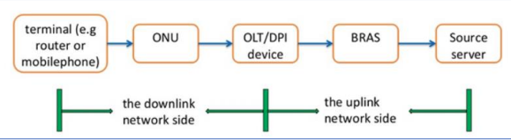
Problem statement
“Classification of Home Network Users to Improve User Experience”
DPI probe divides the broadband end-to-end network into 2 parts:
uplink network side.
downlink network side.
Downlink network side problems account for a large proportion of network problems.
Operators try to detect problems with the network's quality and improve the user’s experience as fast as possible.
Notes:
With the ever-changing and rapid growth of technology with mobile phones and the Internet, the home broadband system has become a key part of many people around the world’s day-to-day life. This increase has led to a progressively saturated market which is dependent upon the user's experience and the quality of broadband networks to determine whether the market is competitive with the users at hand. Many factors affect the user’s online experience. The DPI probe divides the broadband end-to-end network into two parts: the uplink network side and the downlink network side. The network layout is shown in the above figure. Downlink network side problems account for a large proportion of network problems. Many operators have turned their attention to detecting problems with the network's quality and improving the user’s experience as fast as possible. Accurately depicting whether a user is truly experiencing something classified as “good” or “bad” is a big concern for the operators in the future so they may be able to discover a complaint from the user before it ever happens.

Slide 5
DATA
Users:
150 total users, each having a good experience and bad experience csvs as train data
50 users, each having a good experience and bad experience csvs as validation data
50 users, each having a good experience and bad experience csvs as test data
Indicators:
Indicator 1 - Time interval between syn ack packet & ack packet in 3-way handshake.
Indicator 2 - Time interval between syn ack packet & ack packet in 2nd step.
Indicator 3 - Time interval between ack packet & 1st payload packet in 3-way handshake.
Indicator 4 - Response delay of 1st packet with payload after the establishment of TCP for multiple flows in the session.
Indicator 5 - Actual delay of transmission from the DPI position to the user terminal.
Indicator 6 - Transmission delay from the DPI position to the website.
Indicator 7 - Percentage of downlink retransmitted packets in the current session.
Indicator 8 - Percentage of upstream retransmission packets of the current session.
Notes:
Mention that each user had their separate data file on an average 10000 records for each.

Slide 6
Outlier Detection
IQR Method:
Used IQR method to detect and remove extreme values.
Rather than 25th and 75th percentile, we used 4th and 96th percentile.
4th percentile, which means 4% of the data lies between the minimum and Q1.
96th percentile, representing 96% of the data between minimum and Q3.

Slide 7
DATA TRANSFORMATION
Data
Aggregated each user's data into one single record for each user by different fashions.
Flagged each record for good and bad experience based off aggregation.
Ended up with 150 records for good user experience and 150 users for bad user experience in train data.
Min/Max Scaling:
Performed min/max scaling.
Resultant values range between 0 and 1.
This reduces the standard deviation to minimize the effect of outliers.
Notes:
We merged the data on hourly, multi-hour, per day and complete time period and tried modelling. We got best result for the complete time period. Also, while merging we tried different ways to aggregate by taking mean, median, minimum and maximum.

Slide 8
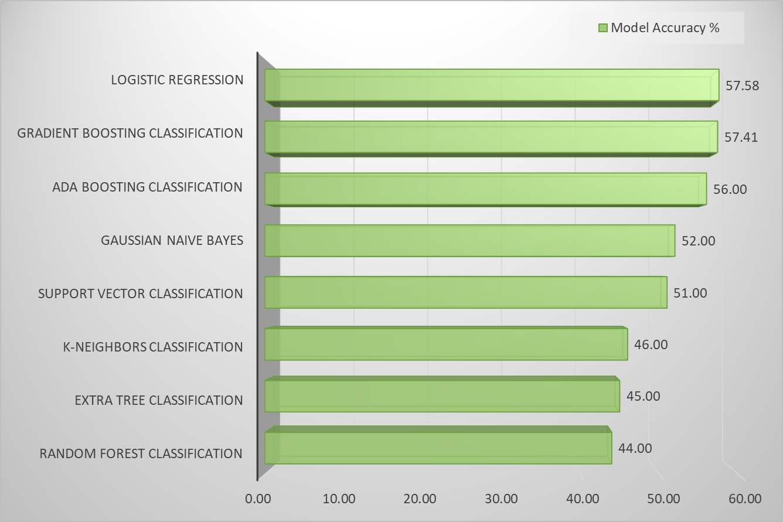
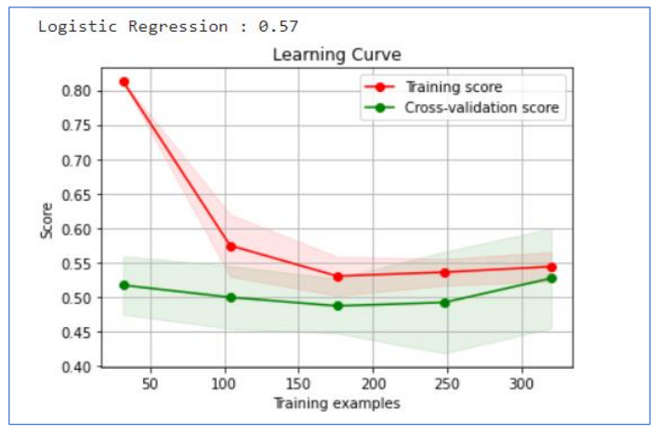
model evaluation Summary
Logistic Regression leads as the best performing model
The green trend line depicts how the logistic regression model performed for the unseen dataset

Slide 9
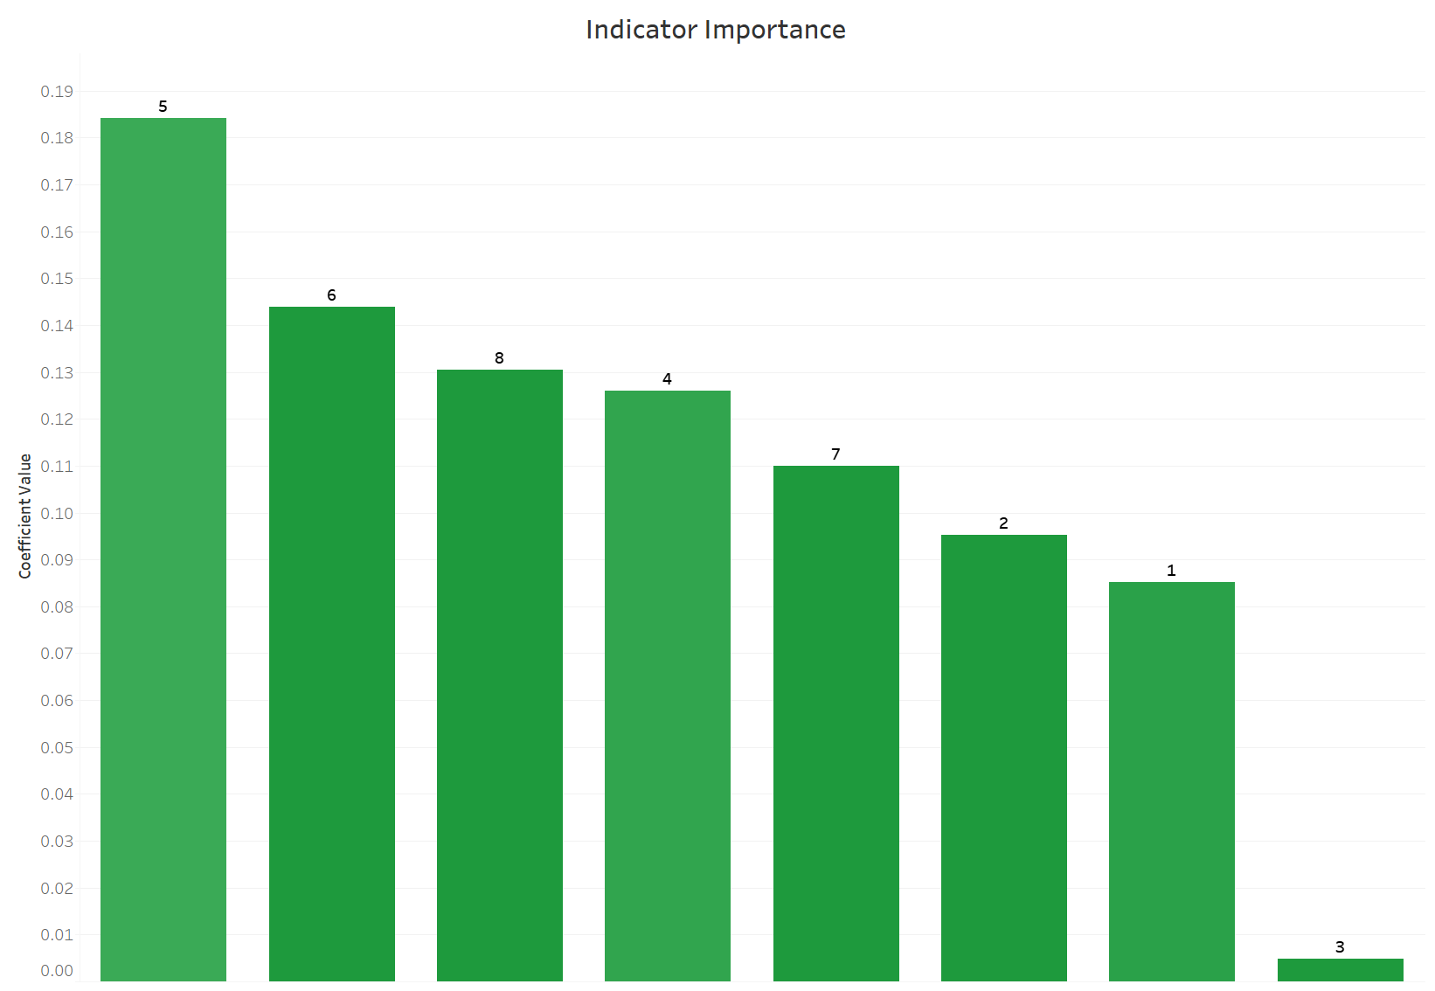
Indicator Importance
Based on the following graph, you can tell indicators 5, 6, and 8 were most influential.
Indicator 3 had very low influence, followed by indicator 1.
Notes:
Indicator 5: Actual delay of transmission from the DPI position to the user terminal.
Indicator 6: Transmission delay from the DPI position to the website.

Slide 10
Business recommendations
Anticipating customer needs and preparing operations to meet them.
Handling issues before customers face them.
Providing assurance to customers that they can get help whenever they need it.
Harness customer data to reduce the churn.
Faster resolution of customer issues.
Notes:
Based on our findings we would recommend looking into the following:
Reasons for Transmission delay (from indicator 5 and 6 as they are most important) can be looked into and can try to figure out what is causing that.
Launch surveys or marketing campaigns to Figure out how much(dollar value) bad user experience is affecting the business
How many users that are changing service were having bad experience
If location data is available, can dig deeper to see if one particular are users are having bad experience and take action
Can put offers out to retain the customers
Weather information can also help in figuring out reason behind bad experience for mitigating it

Slide 11

Future scope
Include the customer's location as well as pricing option data into analysis
Could use more detailed information about the indicators
Notes:
Using the above mentioned, we could use these things to help understand more about the user experience in places with a high population density, or if a customer is purchasing an average network plan rather than one that is faster but more expensive.

Slide 12

Thank You!
You can reach us at:
hmmyers@okstate.edu
kumar.yash@okstate.edu
anuj.singh@okstate.edu
chhavi.nijhawan@okstate.edu
sushma_reddy.mandhadapu@okstate.edu

Slide 13
Appendix

Slide 14
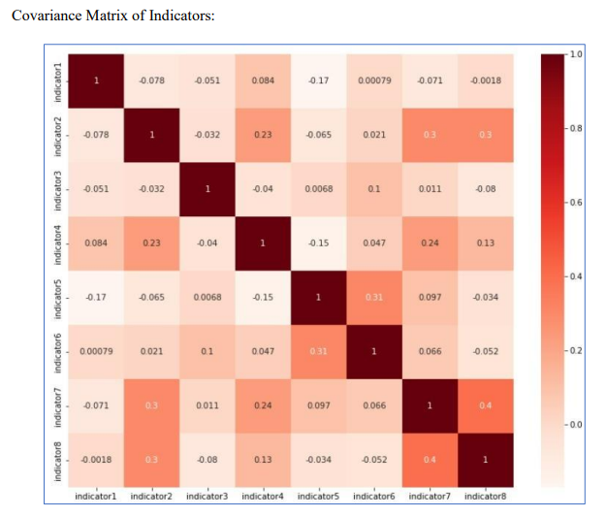
Covariance matrix
None of the indicators were highly correlated

Slide 15
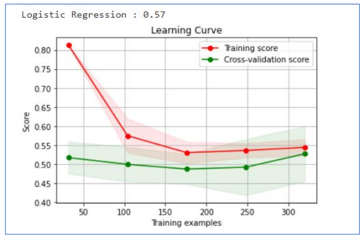
LOGISTIC REGRESSION
Based on a given dataset of independent variables, logistic regression calculates the likelihood that an event will occur.
This model has mathematical assumptions that would not be as accurate as a Neural Network, but we can easily depict variables that are driving the odds.
Accuracy: 57%

Slide 16
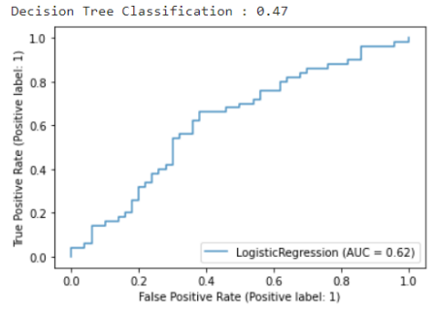
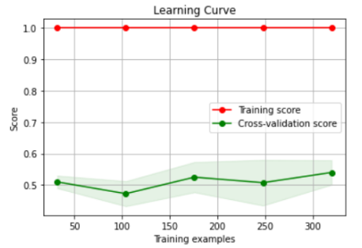
DECISION TREE classification
This model incrementally develops an associated rules while segmenting a dataset into smaller and smaller sections. The outcome is a tree containing leaf nodes and decision nodes.
Accuracy: 47%

Slide 17
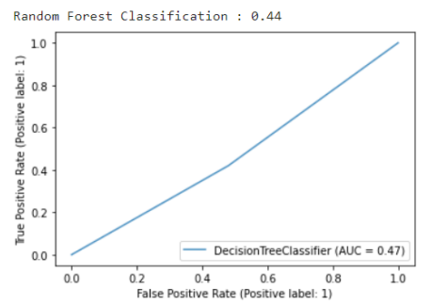
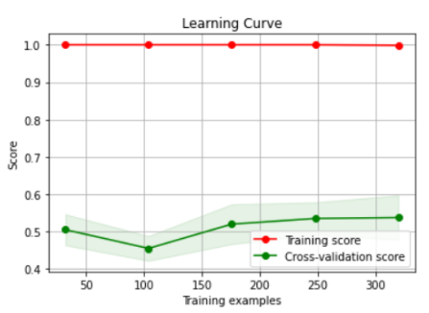
RANDOM FOREST classification
It constructs decision trees and uses their average for classification and majority vote for regression.
Accuracy: 44%

Slide 18
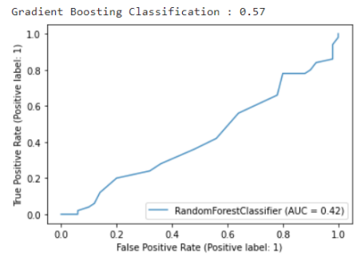
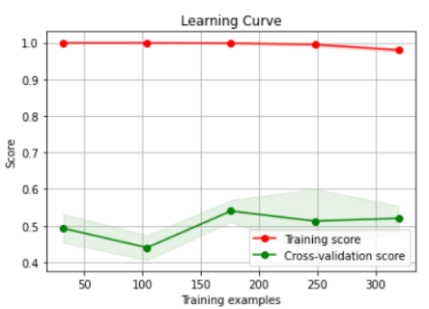
gradient boosting classification
Gradient boosting is one of the variants of ensemble methods where you create multiple weak models and combine them to get better performance.
Accuracy: 57%

Slide 19
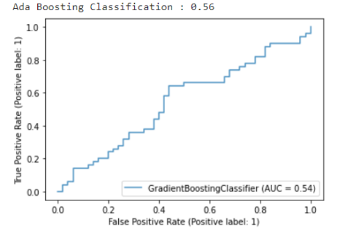
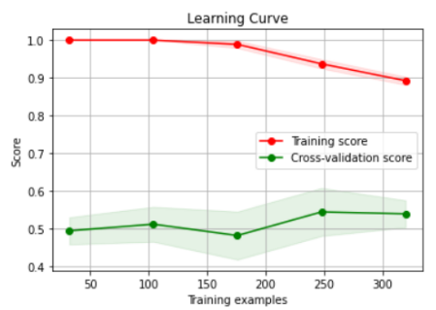
Ada boosting classification
This algorithm constructs a model and assigns equal weights to all data points. It then assigns higher weights to incorrectly classified points. It will continue to train models until a lower error is received.​
Accuracy: 56%​

Slide 20
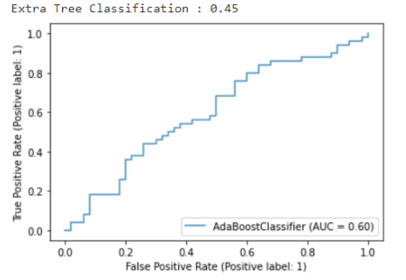
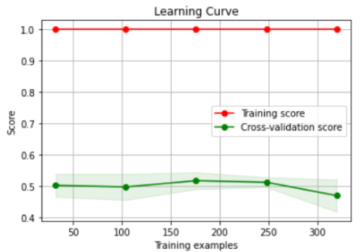
Extra tree classification
At each test node, each tree is given a random sample of k features from the feature set. This random selection of features results forming an ensemble model from de-correlated decision trees.
The evaluated model accuracy for the Extra Tree model is at 45%

Slide 21
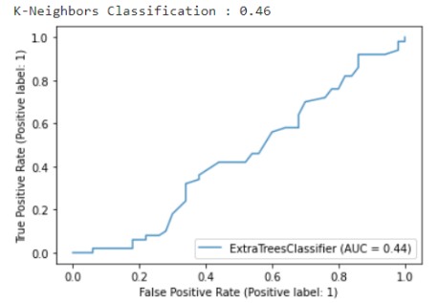
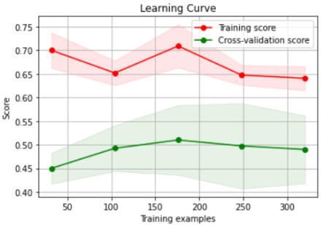
K-Neighbors CLASSIFICATION
KNN chooses the K examples closest to the query, and then, in the case of classification, votes for the label with the highest frequency or averages the labels.
The evaluated model accuracy for the K-Nearest Neighbors model is at 46%.

Slide 22
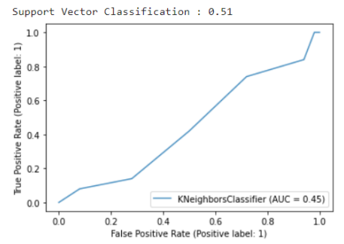
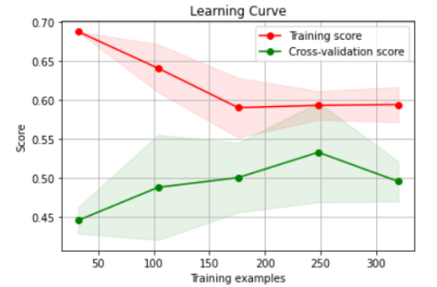
SUPPORT VECTOR CLASSIFICATION
An SVM model can classify new text after being given sets of labeled training data for each category. They offer two key advantages over more recent algorithms like neural networks: greater speed and improved performance.
The evaluated model accuracy for the Support Vector model is at 51%

Slide 23
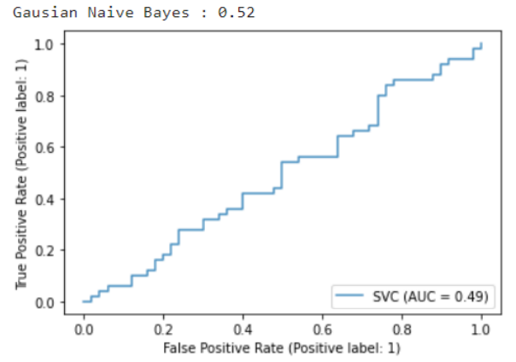
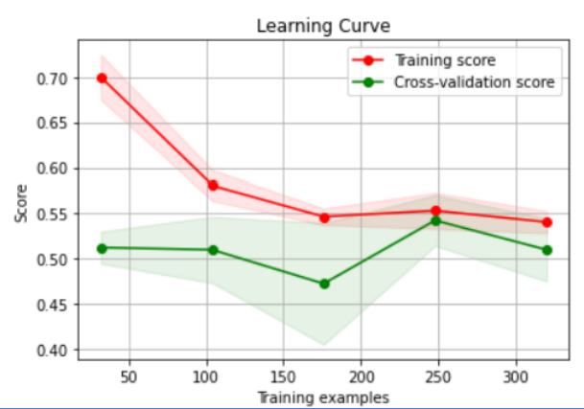
Gaussian Naive Bayes
The concept of independence in classification refers to the idea that the presence of one value of a feature does not influence the presence of another (unlike independence in probability theory).
The evaluated model accuracy for the Gaussian Naive Bayes model is at 52%

